Slide 1
Kubernetes
How to do containers management, load balancing, autoscaling, services discovery, routing in Kubernetes
Date: 18th Oct 2022
Varun Nagpal
(Senior Solution Architect)

Slide 2

About Me
15 + years of Development & Architecture experience
Was working with IBM (Clients: BMO, AirCanada, CN) as Senior Architect before joining OneSpan
Author of Android Development Book (Android Sensor Programing By Example)
Author/Inventor of two patents (machine learning algos)
Hobbyist Apps and Games Developer (40+ games on Apple & Google Stores)

Slide 3
Agenda
Why Containerization?
What is Kubernetes?
Why Kubernetes? (Benefits/Reasons of using Kubernetes)
Kubernetes Industry Adoption
Kubernetes Architecture
Cluster Architecture
Master Node (Control Plane) - Architecture
Worker Node - Architecture
Kubernetes Important Features/Components
Inputs (YAML files) and Types of Objects in Kubernetes
Containers/Pods/Nodes
Pods Resource Allocation
Auto Bin Packing
Number of pods/nodes and their resources (CPU/RAM) for App Shielding (Frontend/Backend)
Storage Orchestration in Kubernetes
Secrets and Configs Management in Kubernetes
What are Services in Kubernetes?
Service Registry and Discovery, Internal Load Balancing in Kubernetes

Slide 4
Agenda - Continue
Ingress and Ingress Controller
Routing (Internal/Kubernetes Cluster and External/Public Internet)
Health Checks (Startup, Liveness, Readiness)
Health Check - Manage Pods LifeCycle
Helm Charts
Auto Scaling in Kubernetes
Horizontal Scaling
Pods (Scaling Number of Pods) via HorizontalPodAutoscaler (HPA)
Nodes (Scaling Number of Nodes) via Cluster Autoscaler
Vertical Scaling
Pods (Scaling RAM/CPU for Pods) via VerticalPodAutoscaler (VPA)
Kubernetes Jobs (For Executing App Shielding Runners)
Kubernetes Dashboards/UIs
What is Terraform?
Terraform vs Kubernetes
Demo/Code Review for our App Shielding K8s Cluster (Pods, ReplicaSets, Services, Ingress, Routing)
Frontend, Projects, Shielder, Config, Shielding
Automate Creation/Destruction of Environments/K8s Cluster
Appendix -
Reference Links
Sample Infrastructure Diagram

Slide 5
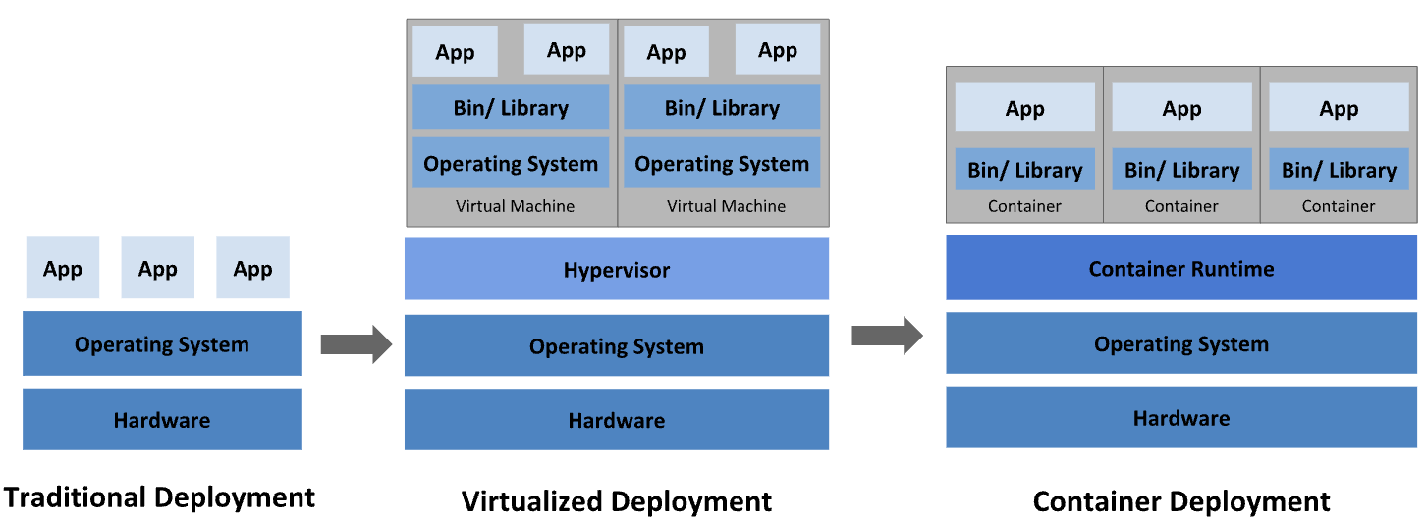
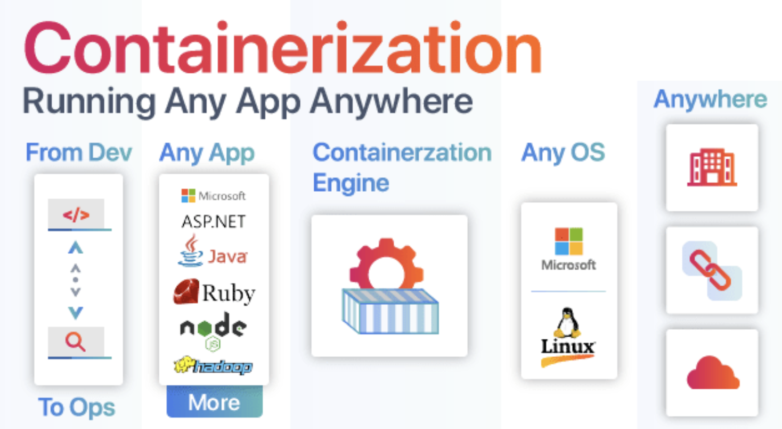
Why Containerization?

Slide 6
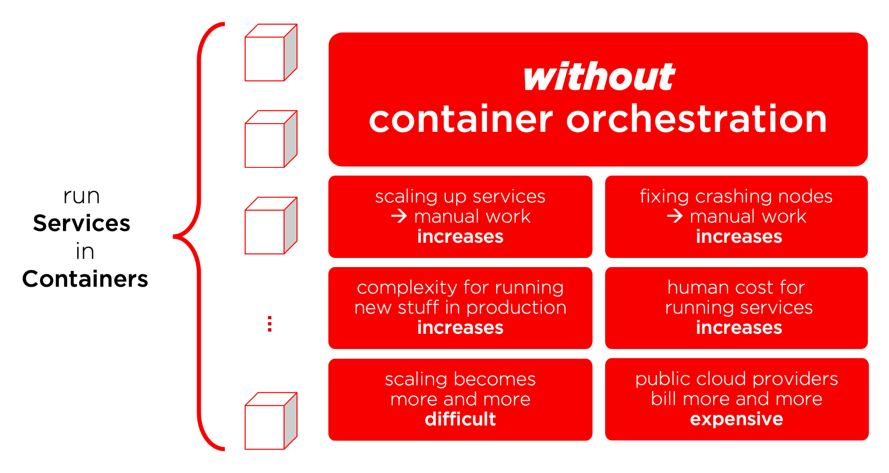
Without Container Orchestration
Notes:
Service discovery and load balancing Kubernetes can expose a container using the DNS name or using their own IP address. If traffic to a container is high, Kubernetes is able to load balance and distribute the network traffic so that the deployment is stable.
Storage orchestration Kubernetes allows you to automatically mount a storage system of your choice, such as local storages, public cloud providers, and more.
Automated rollouts and rollbacks You can describe the desired state for your deployed containers using Kubernetes, and it can change the actual state to the desired state at a controlled rate. For example, you can automate Kubernetes to create new containers for your deployment, remove existing containers and adopt all their resources to the new container.
Automatic bin packing You provide Kubernetes with a cluster of nodes that it can use to run containerized tasks. You tell Kubernetes how much CPU and memory (RAM) each container needs. Kubernetes can fit containers onto your nodes to make the best use of your resources.
Self-healing Kubernetes restarts containers that fail, replaces containers, kills containers that don't respond to your user-defined health check, and doesn't advertise them to clients until they are ready to serve.
Secret and configuration management Kubernetes lets you store and manage sensitive information, such as passwords, OAuth tokens, and SSH keys. You can deploy and update secrets and application configuration without rebuilding your container images, and without exposing secrets in your stack configuration.

Slide 7
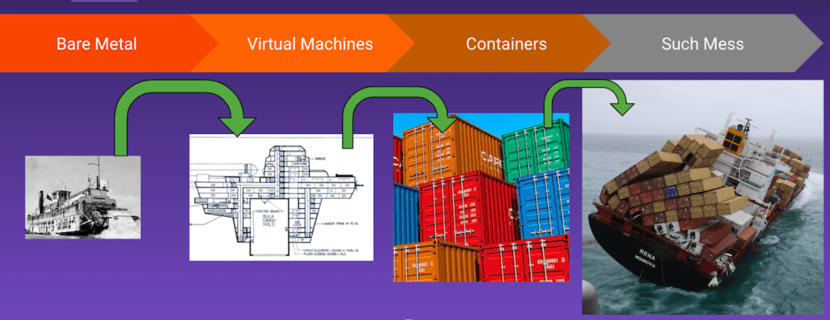
What is Kubernetes?
Kubernetes is a portable, extensible, open source platform for managing containerized workloads and services, that facilitates both declarative configuration and automation. (Orchestration for Containers).
It can run distributed systems resiliently. It takes care of scaling and failover for your application, provides deployment patterns.
Google open-sourced the Kubernetes project in 2014. The name Kubernetes originates from Greek, meaning helmsman or pilot. K8s as an abbreviation results from counting the eight letters between the "K" and the "s"

Slide 8
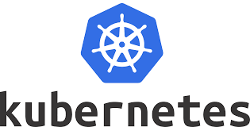
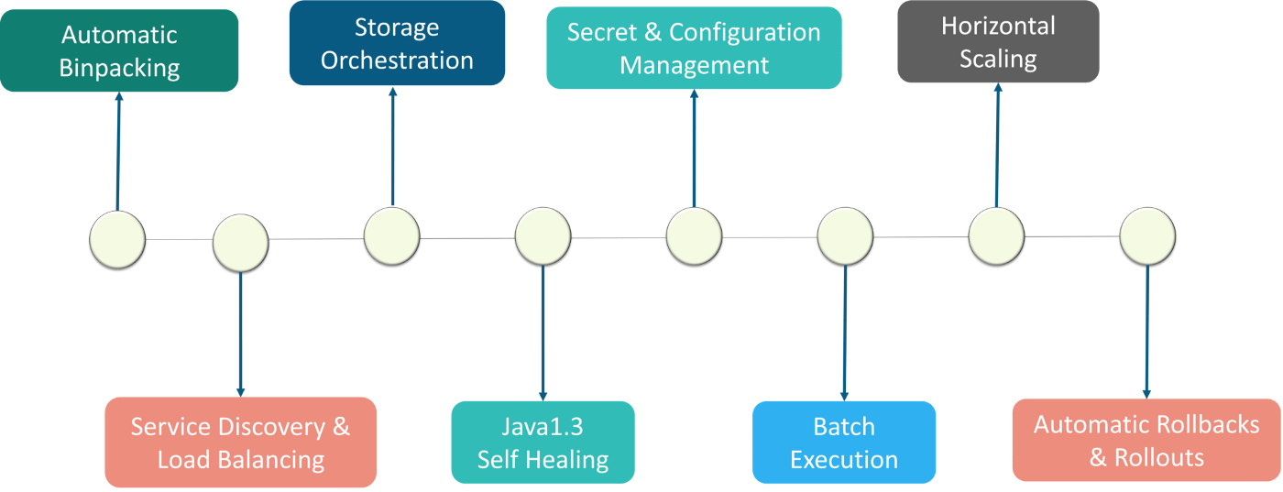
Why Kubernetes? (Benefits/Reasons of using Kubernetes)
Notes:
Service discovery and load balancing Kubernetes can expose a container using the DNS name or using their own IP address. If traffic to a container is high, Kubernetes is able to load balance and distribute the network traffic so that the deployment is stable.
Storage orchestration Kubernetes allows you to automatically mount a storage system of your choice, such as local storages, public cloud providers, and more.
Automated rollouts and rollbacks You can describe the desired state for your deployed containers using Kubernetes, and it can change the actual state to the desired state at a controlled rate. For example, you can automate Kubernetes to create new containers for your deployment, remove existing containers and adopt all their resources to the new container.
Automatic bin packing You provide Kubernetes with a cluster of nodes that it can use to run containerized tasks. You tell Kubernetes how much CPU and memory (RAM) each container needs. Kubernetes can fit containers onto your nodes to make the best use of your resources.
Self-healing Kubernetes restarts containers that fail, replaces containers, kills containers that don't respond to your user-defined health check, and doesn't advertise them to clients until they are ready to serve.
Secret and configuration management Kubernetes lets you store and manage sensitive information, such as passwords, OAuth tokens, and SSH keys. You can deploy and update secrets and application configuration without rebuilding your container images, and without exposing secrets in your stack configuration.

Slide 9
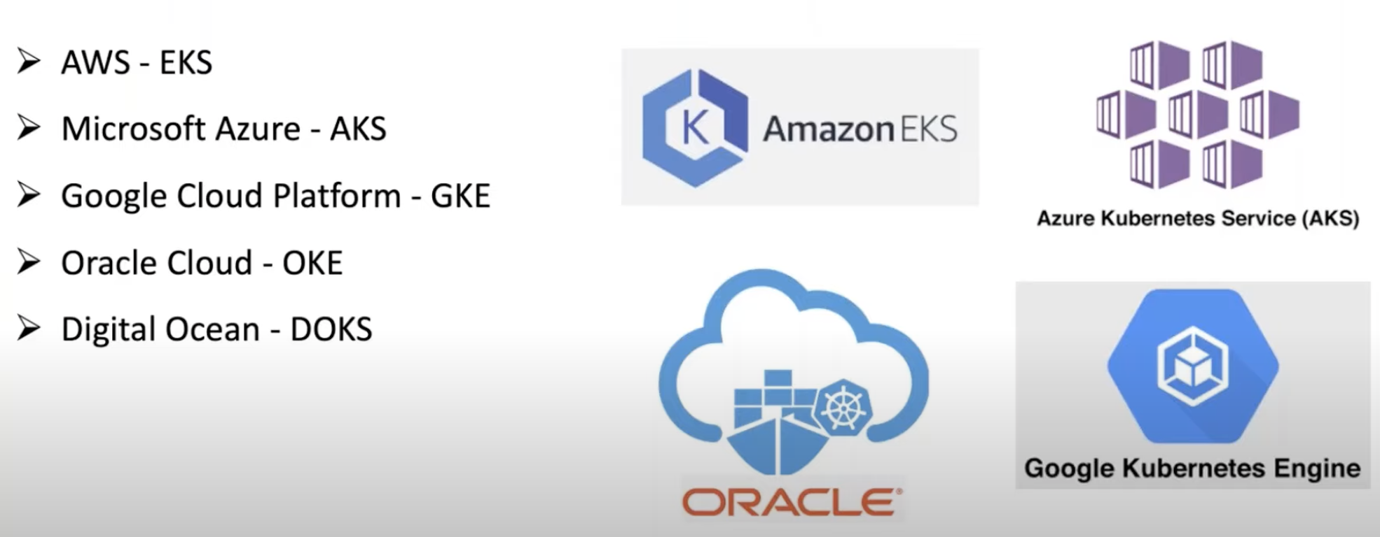
Kubernetes Industry Adoption

Slide 10
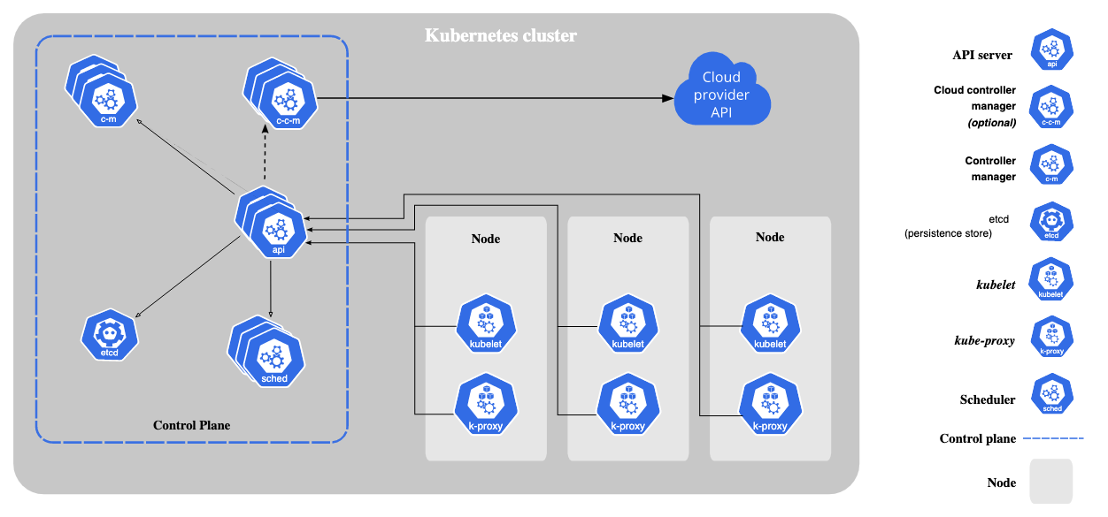
Kubernetes Architecture
https://kubernetes.io/docs/concepts/overview/components/

Slide 11
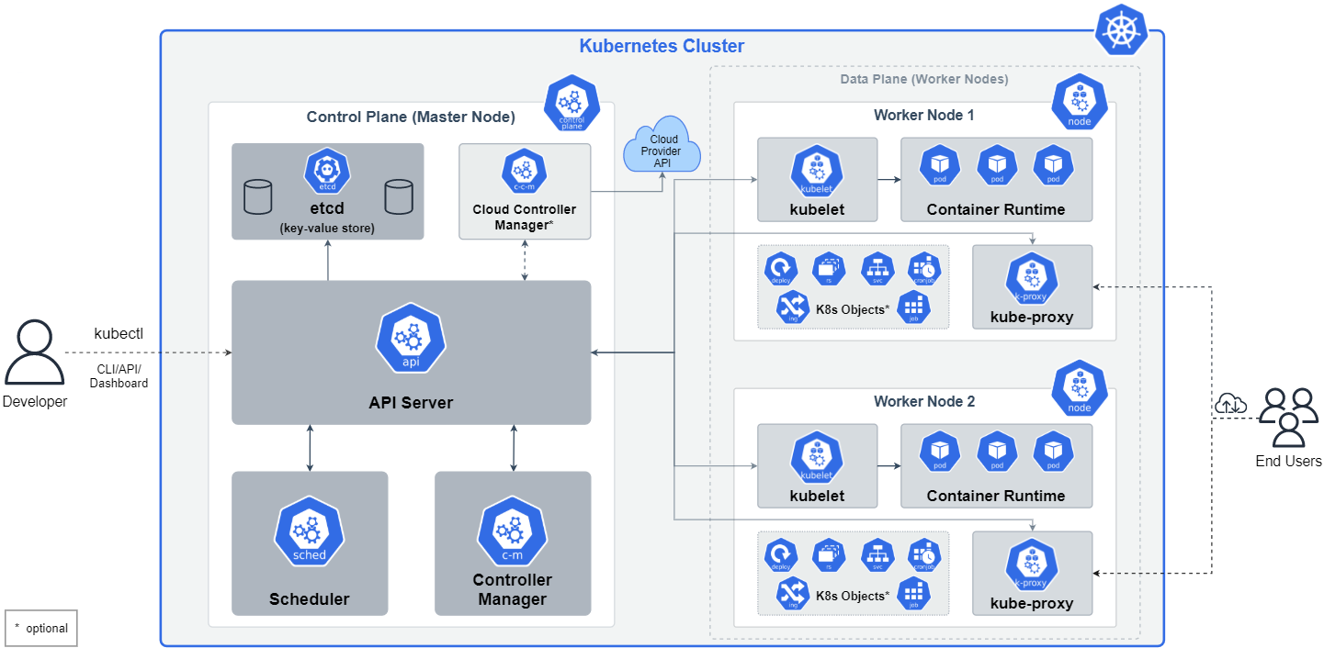
Kubernetes - Cluster Architecture

Slide 12
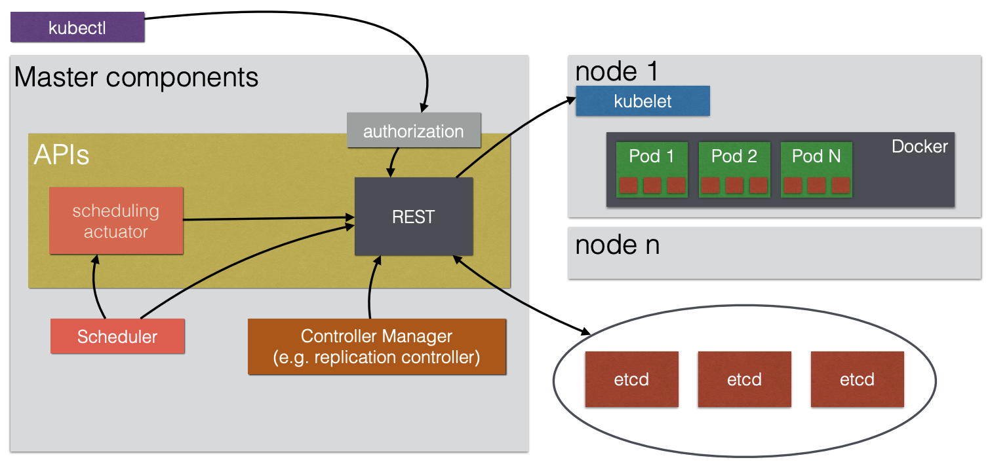
Kubernetes - Master Node (Control Plane) Architecture
Kubectl
Authorization
REST API Server
Controller Manager
Scheduler
Etcd (Data Store)
One or Many Nodes

Slide 13
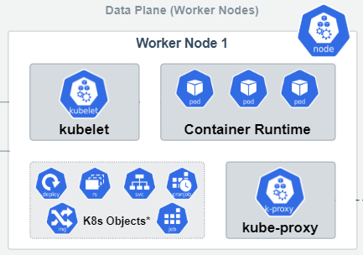
Kubernetes - Worker Nodes Architecture
Kubelet
An agent that runs on each node in the cluster. It makes sure that containers are running in a Pod. The kubelet takes a set of PodSpecs that are provided through various mechanisms and ensures that the containers described in those PodSpecs are running and healthy.
Kube Proxy
kube-proxy is a network proxy that runs on each node in your cluster, implementing part of the Kubernetes Service concept. kube-proxy maintains network rules on nodes. These network rules allow network communication to your Pods from network sessions inside or outside of your cluster.
Container Runtime
The container runtime is the software that is responsible for running containers (in Pods).
To run the containers, each worker node has a container runtime engine.
It pulls images from a container image registry and starts and stops containers.
Containers Supported
Docker
containerd
CRI-O
Any implementation of the Kubernetes CRI (Container Runtime Interface).
K8s Objects (*Optional)
Service, Jobs, Cron Job, Ingress, etc.

Slide 14
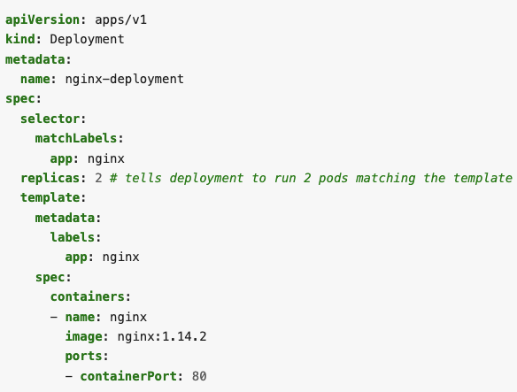
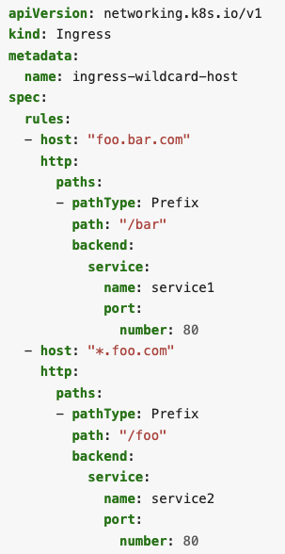
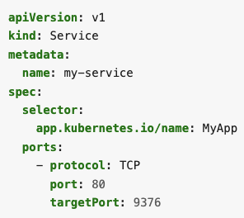
Inputs (YAML files) and Types of Objects in Kubernetes
All Inputs to Kubernetes are given in YAML files (Each Object -> YAML file)
Each Object/Configuration File in Kubernetes has 4 parts
API version
Metadata
Specification
Status
Types (Kind) of Object/YAML files in Kubernetes (Defined through KIND Tag in Yaml file)
Pods
ReplicaSets
Deployments
Services
Ingress
Etc
Ideally store with the code or in separate Git Repository.

Slide 15
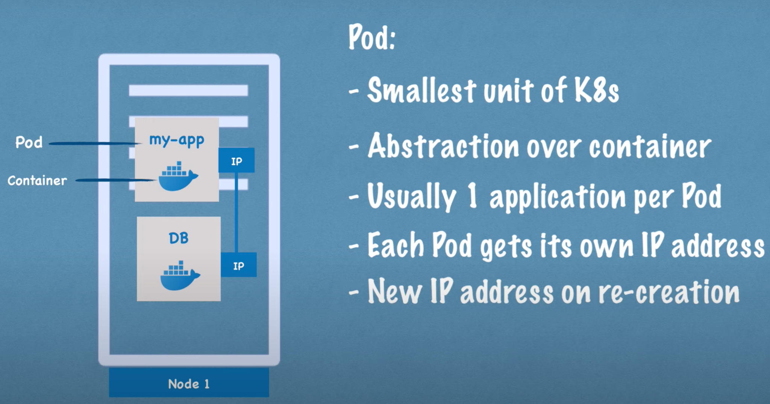
Container/Pod/Node

Slide 16
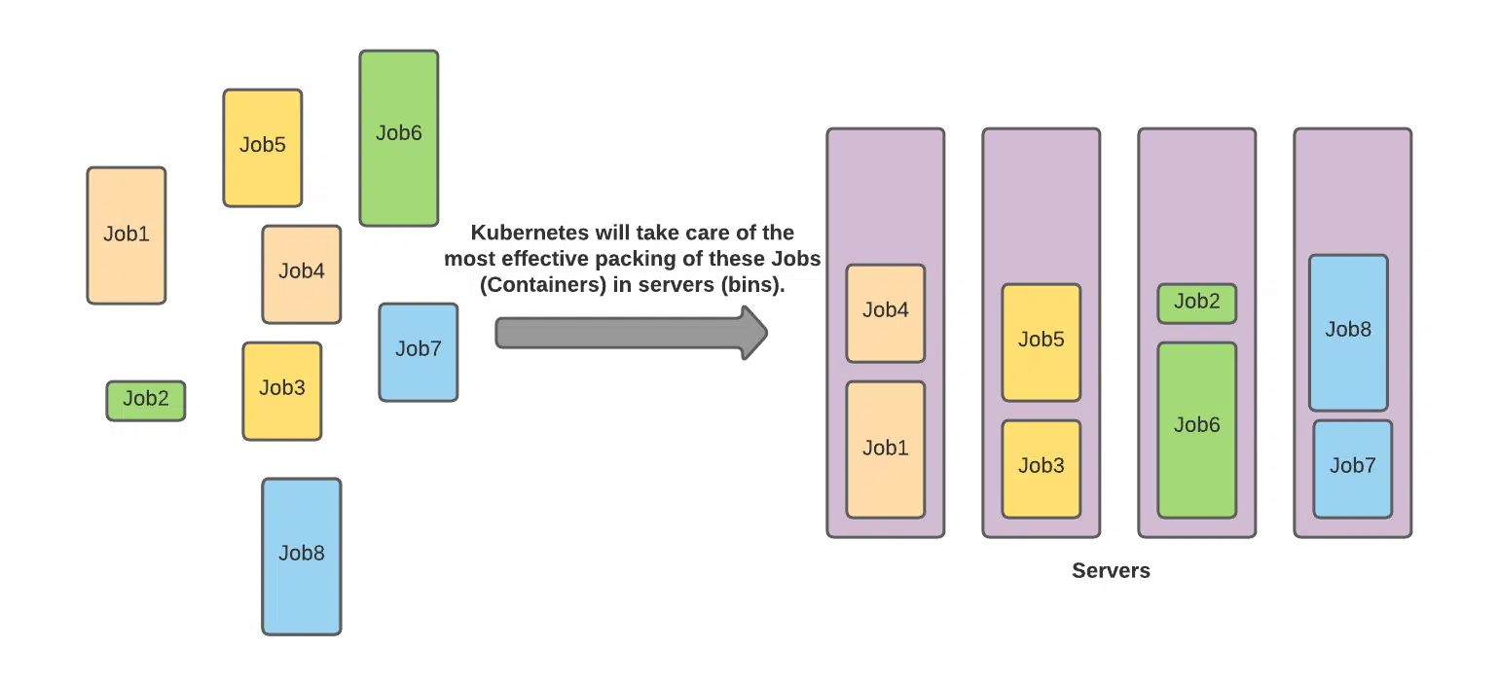
Auto Bin Packing by Kubernetes
Kubernetes will decide based on your Containers requested resources, what is the best fit for your bins(containers) in the allocated(available) servers.

Slide 17
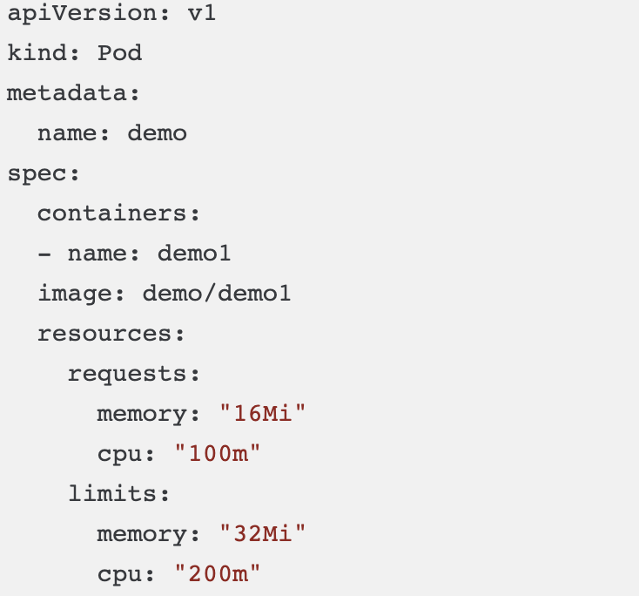
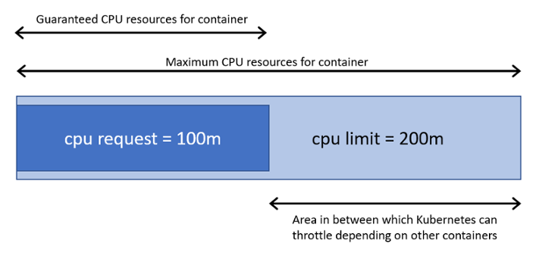
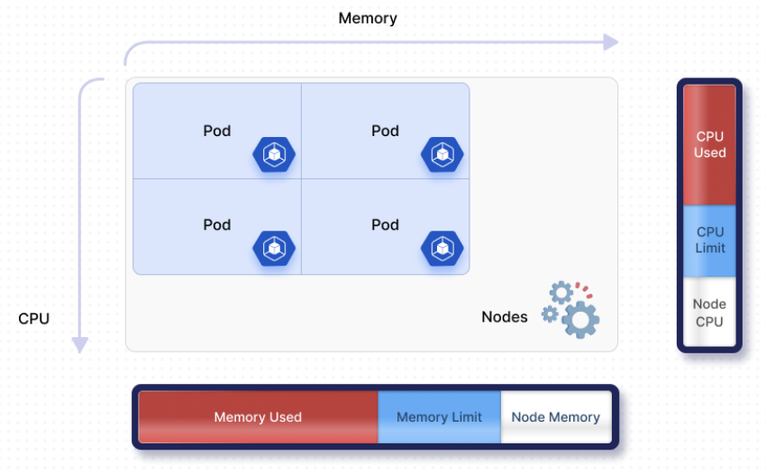
Containers/Pods Resource Allocation
Pod with
100m CPU/16m RAM
https://git.onespan.com/mob/saas/rasp-configuration-be/-/blob/main/helm/values.tmpl.yaml
What should be the resources (CPU/RAM) for a Container/Pod? (512 RAM, 1 CPU)??
1 Core CPU -> 1000 milli CPU (1000m)
1 GB RAM -> 1000 mb RAM (1000Mi)
Requests and Limits

Slide 18
Number of pods and their resources (CPU/RAM) for App Shielding
Resources (Size and Count)
What should be the resources (CPU/RAM) for a Container/Pod? (512RAM, 1CPU)??
How many Container/Pods we need for each Microservice or Frontend Server? (2,3,n Pods)??
Process (How to get the right resources size and count for App Shielding Microservices/Frontend)
Input from Legacy App (Existing Users/Traffic) + Product Team (Future Estimates) -> Create NFRs
NFRs
Max, Average Concurrent Users, SLA, HA, TPS, Disaster Recovery, etc.
Translate expected average load into (using 4 Steps process in Appendix)
Resource size (CPU/RAM) for a Container X Number of Containers needed to support that load
Setup Auto Scaling Up (Horizontal) to meet the increased load on special releases/days.
Also set up auto scaling down (horizontal), when the load has gone back to normal.

Slide 19
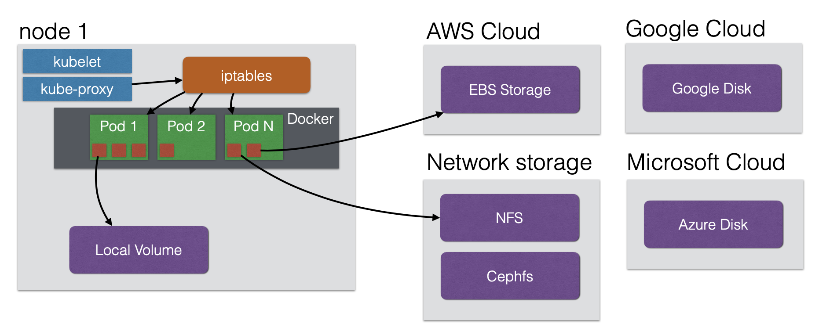
Storage Orchestration in Kubernetes
Pods/Containers are mortal, they cannot persist data. Need an external storage to persist data.
Kubernetes provides storage orchestration support
Ability to attach external volume/storage, which will persist beyond Pods Life cycle.
Local Volume, AWS EBS, Google Disk, Azure Disk, Network Storage, etc. are supported.

Slide 20
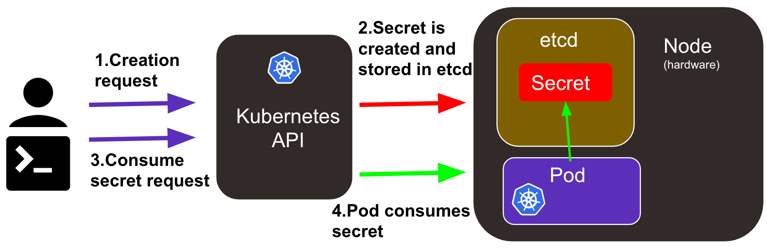
Secrets and Config maps Management in Kubernetes
Configs Maps
To Store Key Value Pairs (In Plain Text)
Stored in (Etcd) - Accessible to all pods
Examples
nginx.conf (any config files)
environment variables, etc.
Secrets
To Store Secrets/Sensitive Info (Hashed/Base64 Encoded, Not in Plain Text)
Stored in (Etcd) - Accessible to all pods
Examples
Root Password for database
API keys, tokens, etc.

Slide 21
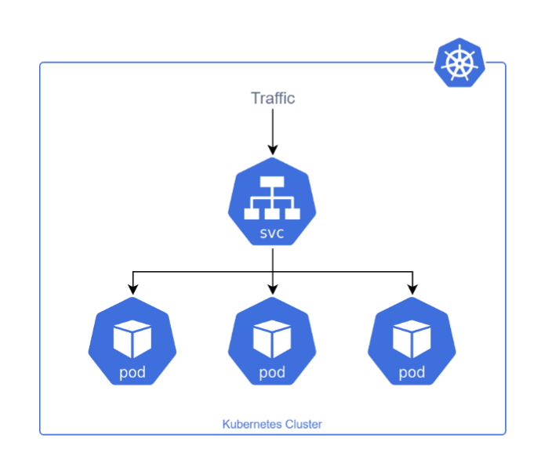
Kubernetes Service
Kubernetes Service is used to expose an application deployed on a set of pods using a single endpoint. Services are introduced to provide reliable networking by bringing stable IP addresses and DNS names to mortal pods. Service enables network access to a set of Pods in Kubernetes.
Main Responsibilities of Service
Service Registry with CoreDNS (Service Registry)
Single Routing For Multiple Pods (Service Discovery)
Traffic Management For Multiple Pods (Load Balancing)
Major Types of Service
ClusterIP (Default)
NodePort
Load Balancer
External Name

Slide 22
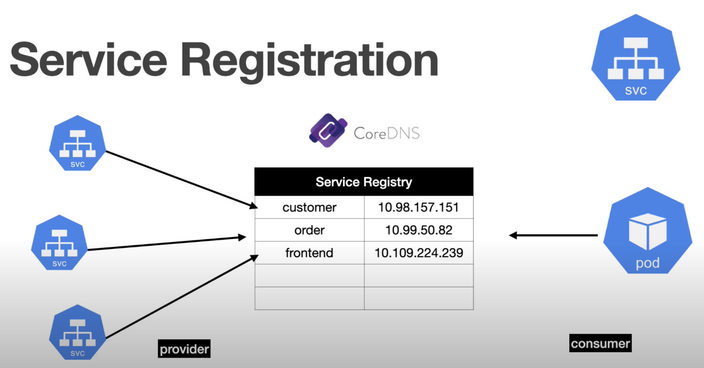
Service Registry, Discovery & Load Balancing

Slide 23
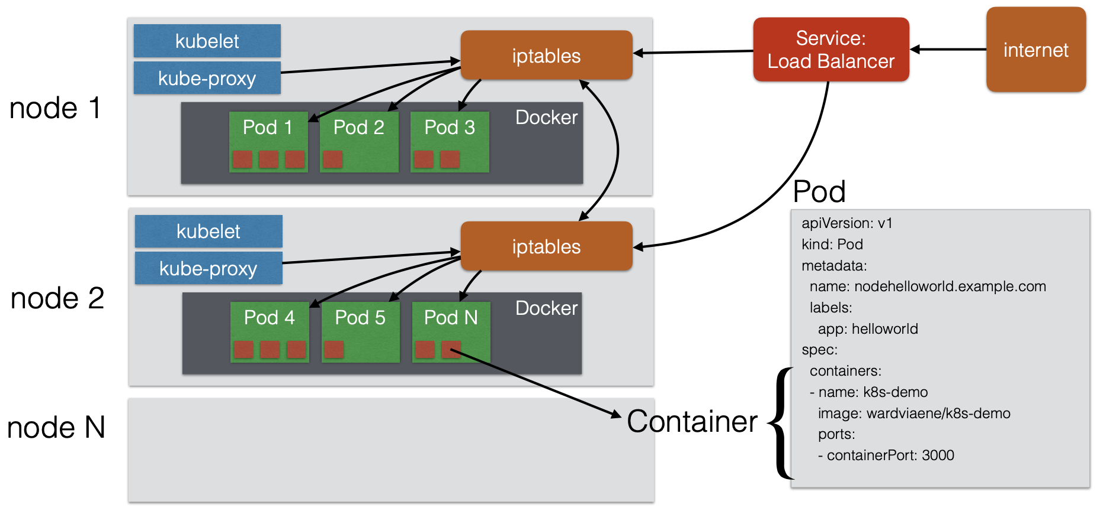
Service Registry, Discovery & Load Balancing

Slide 24
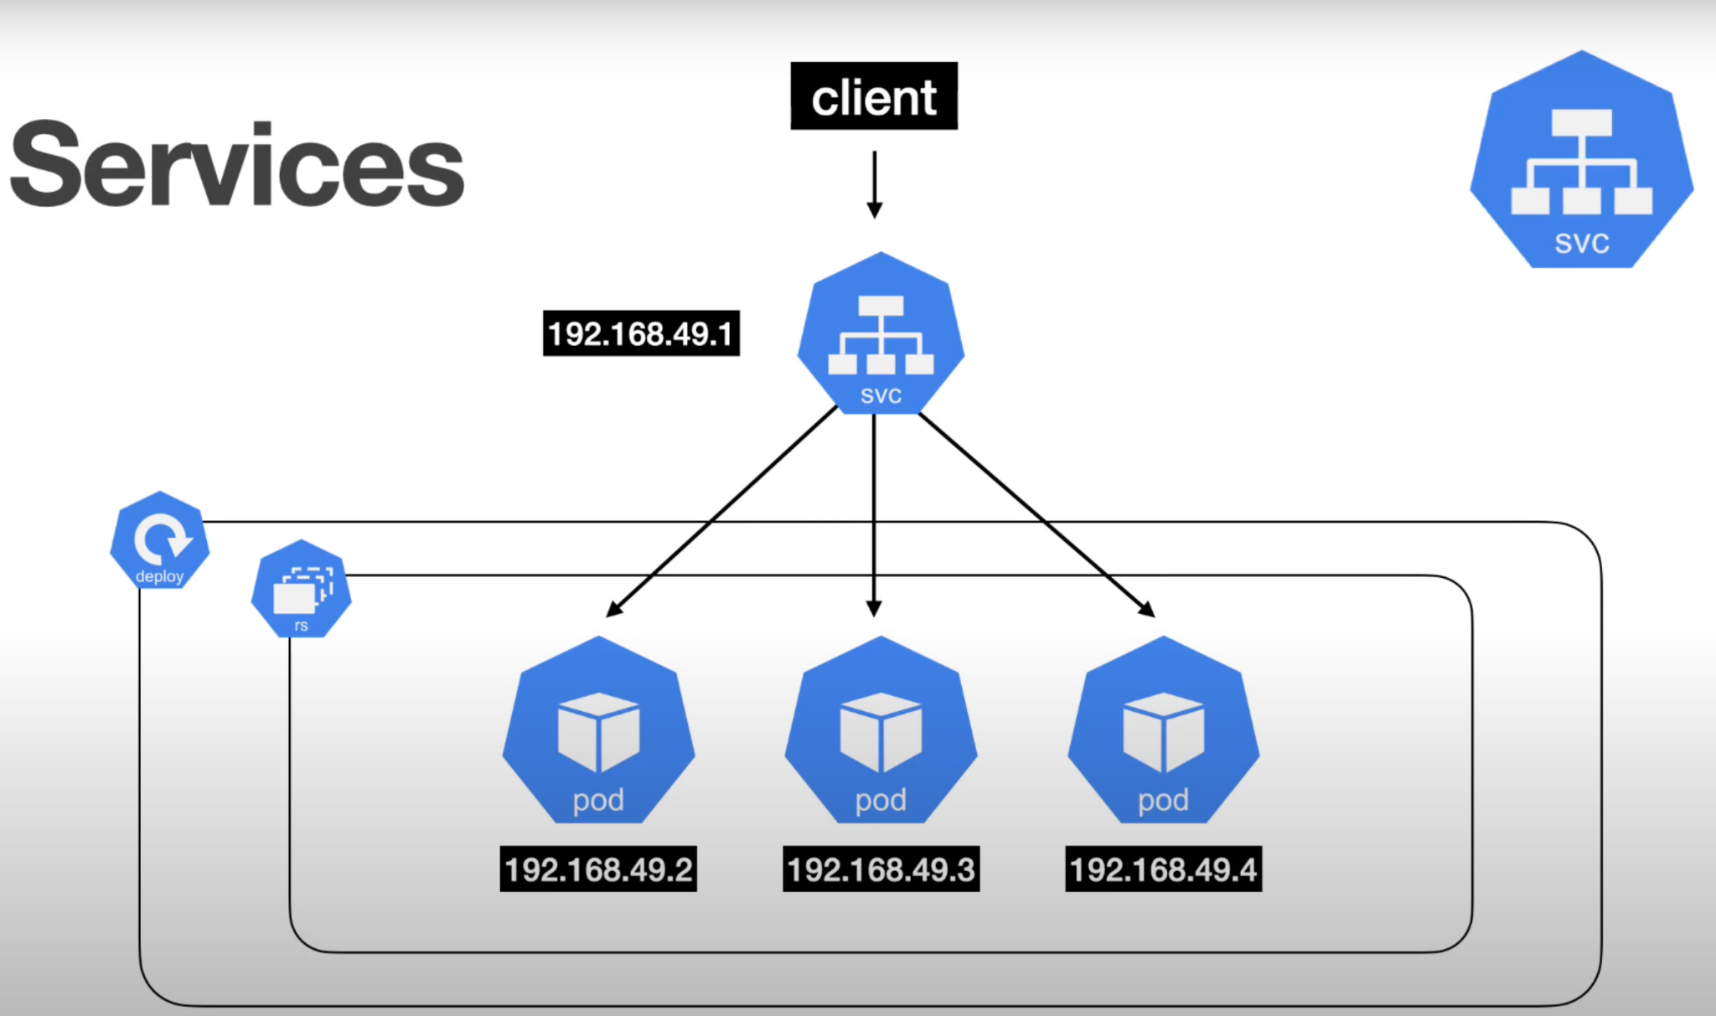
Service Registry, Discovery & Load Balancing

Slide 25
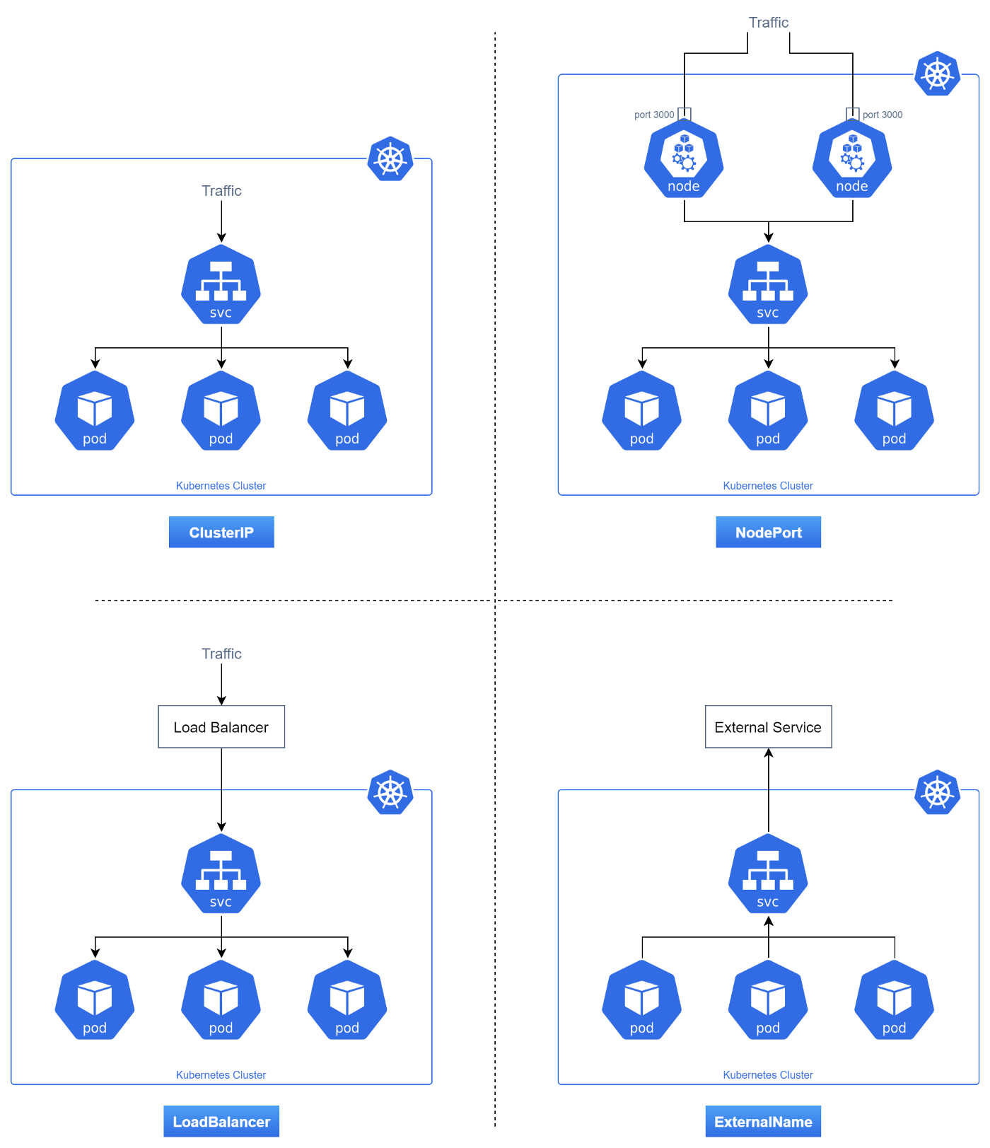
Types of Kubernetes Service
ClusterIP (Default)
ClusterIP is the default and most common service type.
Kubernetes will assign a cluster-internal IP address to ClusterIP service. This makes the service only reachable within the cluster.
You cannot make requests to service (pods) from outside the cluster.
NodePort
NodePort service is an extension of ClusterIP service.
It exposes the service outside of the cluster by adding a cluster-wide port on top of ClusterIP.
NodePort exposes the service on each Node’s IP at a static port (the NodePort). Each node proxies that port into your Service. So, external traffic has access to fixed port on each Node. It means any request to your cluster on that port gets forwarded to the service.
Load Balancer
LoadBalancer service is an extension of NodePort service.
It integrates NodePort with cloud-based load balancers.It exposes the Service externally using a cloud provider’s load balancer.
Each cloud provider (AWS, Azure, GCP, etc) has its own native load balancer implementation. The cloud provider will create a load balancer, which then automatically routes requests to your Kubernetes Service.
Traffic from the external load balancer is directed at the backend Pods. The cloud provider decides how it is load balanced.
External Name/Service
Services of type External Name map a Service to a DNS name, not to a typical selector such as my-service.You specify these Services with the `spec.externalName` parameter.
It maps the Service to the contents of the external Name field (e.g. foo.bar.example.com), by returning a CNAME record with its value.No proxying of any kind is established.

Slide 26
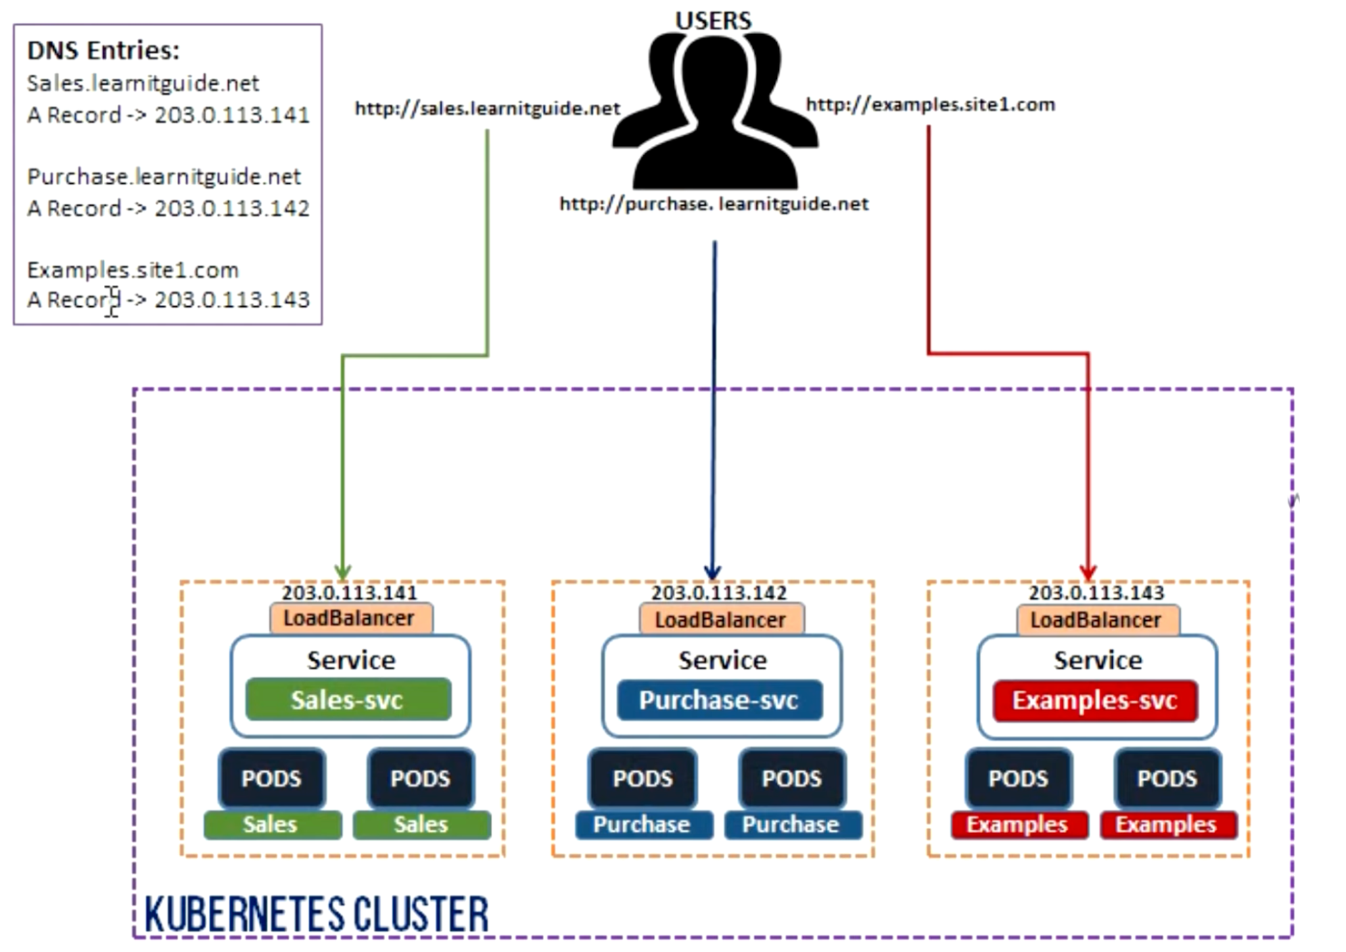
Exposing Services to Internet (Without Ingress)

Slide 27
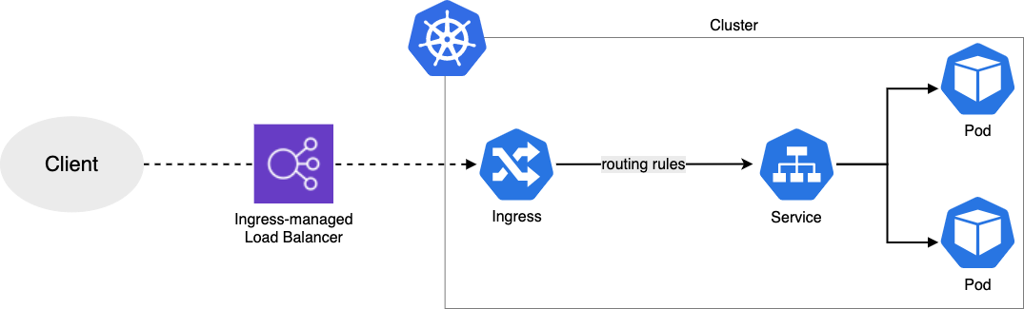
Ingress
Ingress exposes HTTP and HTTPS routes from outside the cluster to services within the cluster.
Traffic routing is controlled by rules defined on the Ingress resource.
An Ingress may be configured to terminate SSL/TLS.
An Ingress does not expose arbitrary ports or protocols. Exposing services other than HTTP and HTTPS to the internet typically uses a service of Service.Type=NodePort or Service.Type=LoadBalancer.

Slide 28
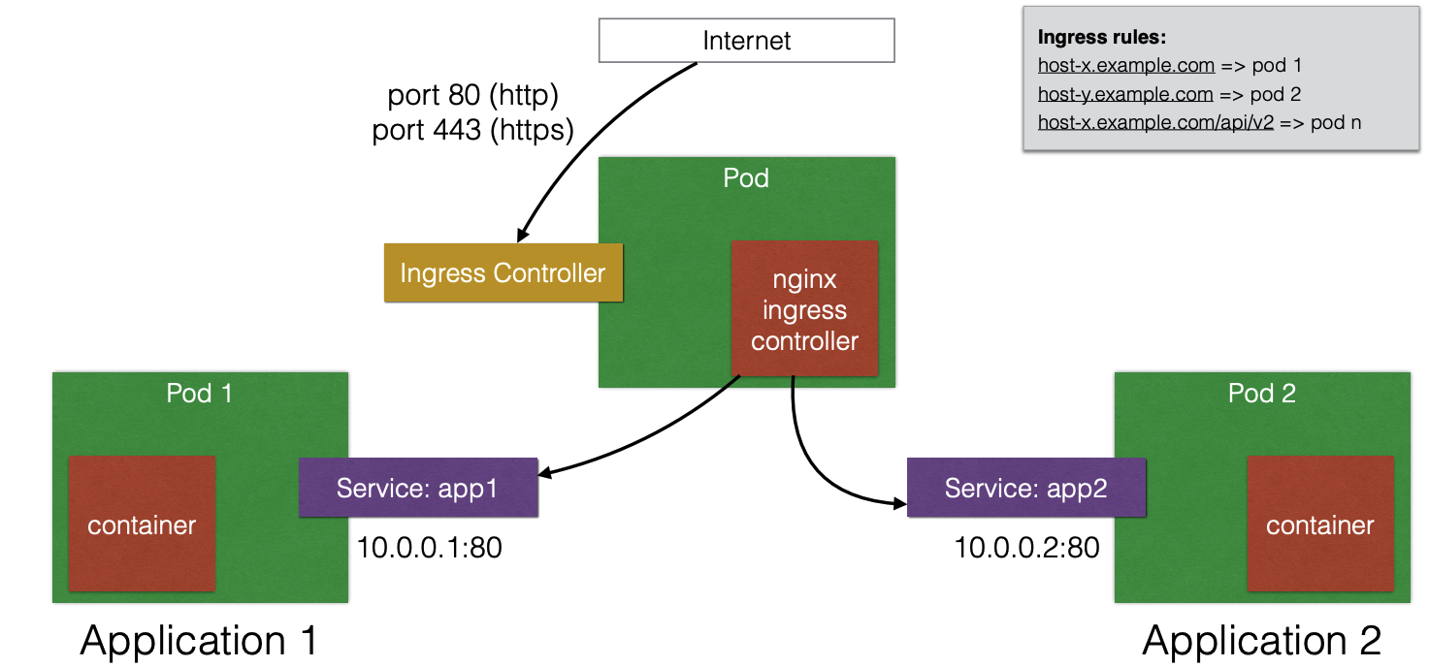
Ingress Controller
You must have an ingress controller to satisfy an Ingress. Only creating an Ingress resource has no effect.
It listens on specific ports (usually 80 and 443) for web traffic
Watches for the creation, modification, or deletion of Ingress Resources
Creates internal L7 routing rules based on desired state indicated by Ingress Objects

Slide 29
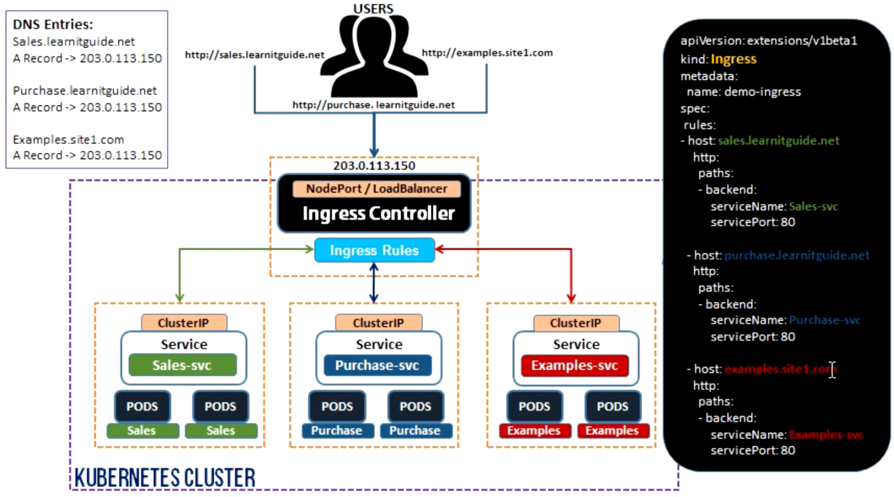
Exposing Services to Internet (YAML + DNS Entries Example)

Slide 30
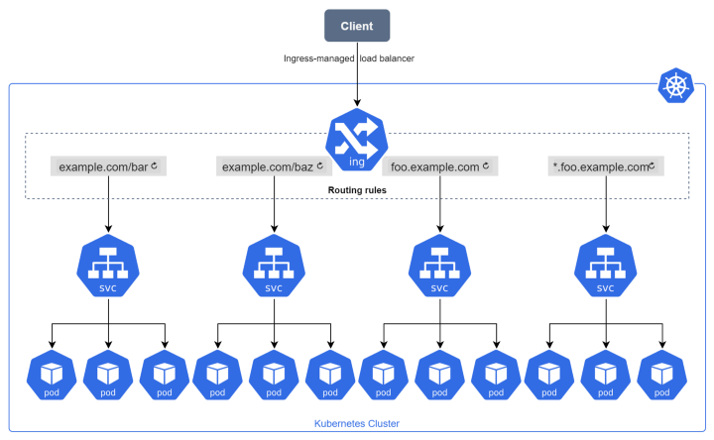
Internal and External Routing
Internal Routing - (Within Kubernetes Cluster) via (In Cluster CoreDNS/IP Tables via Services)
External Routing - (Over Public Internet) via (Public DNS + Ingress Controller)
Fix Current Routing Issue with FE

Slide 31
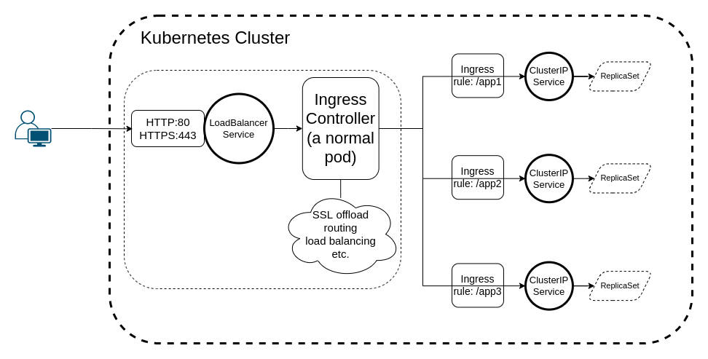
Ingress Controller Pod with Separate AWS ELB
Separate SSL termination, Stable IP/Domain Name, High Availability, High Performance, etc.

Slide 32
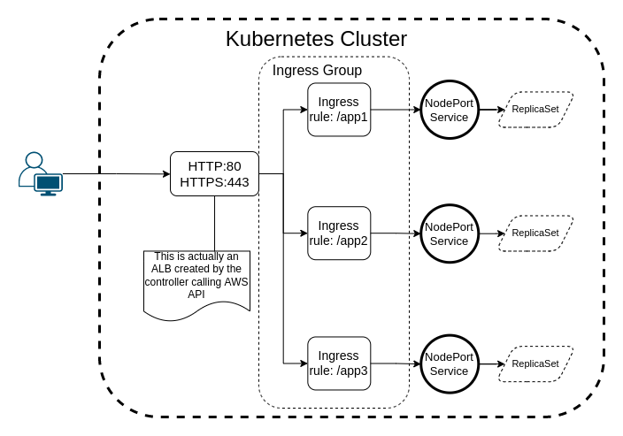
Ingress Controller Combined with AWS ALB

Slide 33
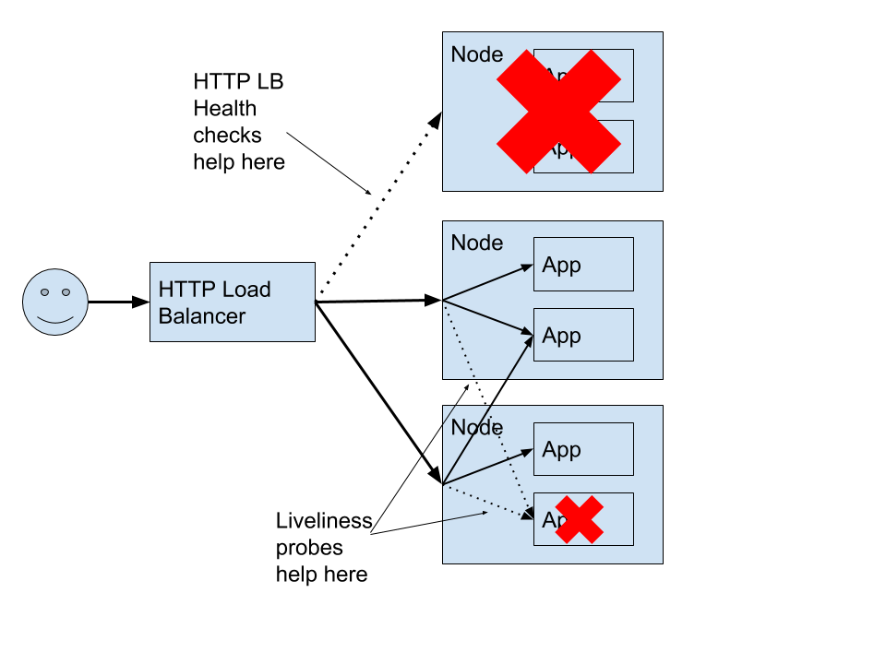
Health Check
Why Health Checks are needed? Load Balancer also performs Health Check, how is this different?
Kubernetes supports 3 types of health checks (performed by KUBELET)
Startup Probe
Readiness Probe
Liveness Probe

Slide 34
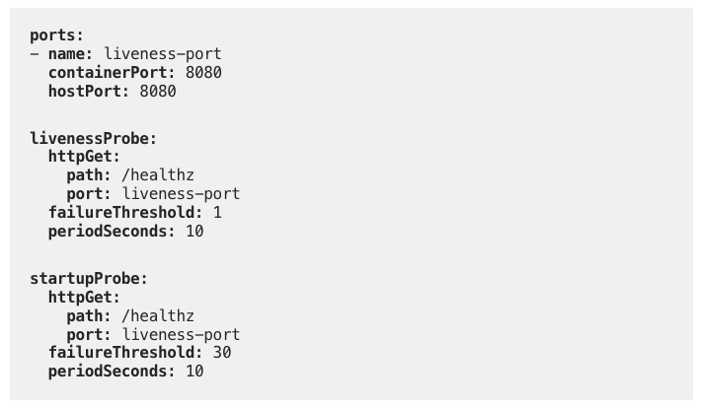
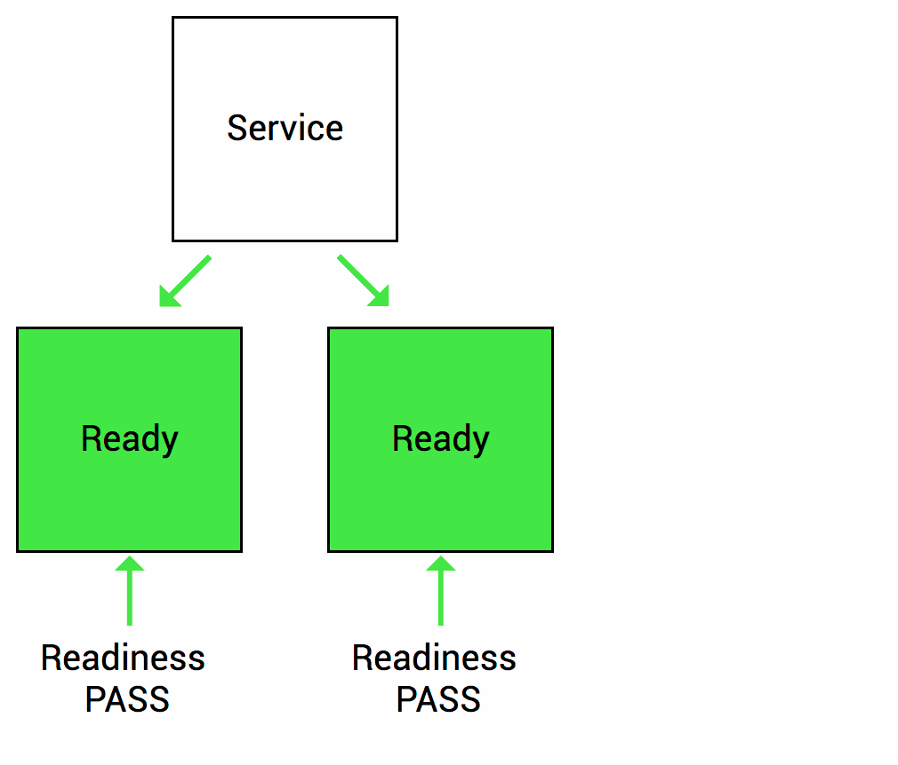
Health Check - Startup and Liveness Probe
Example of Startup Probe
Startup Probe
initialDelaySeconds: Number of seconds after the container has started before liveness or readiness probes are initiated.
periodSeconds: How often (in seconds) to perform the probe.
failureThreshold: Minimum consecutive fails for the probe to be considered restarting the container. In the case of readiness probe, the Pod will be marked Unready.

Slide 35
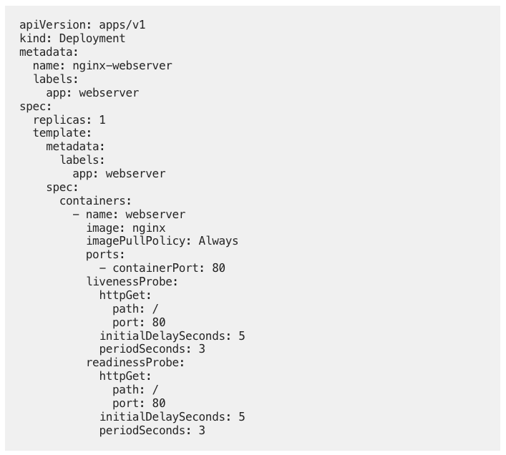
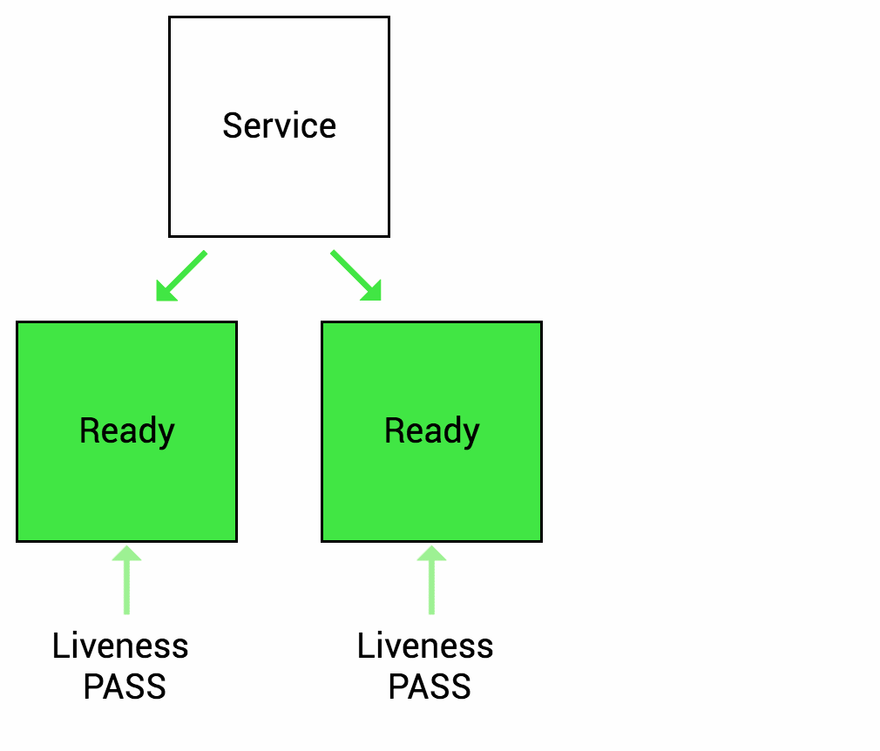
Health Check - Liveness Probe
Liveness Probe
Example of Liveness and Readiness Probe
initialDelaySeconds: Number of seconds after the container has started before liveness or readiness probes are initiated.
periodSeconds: How often (in seconds) to perform the probe.
failureThreshold: Minimum consecutive fails for the probe to be considered restarting the container. In the case of readiness probe, the Pod will be marked Unready.

Slide 36
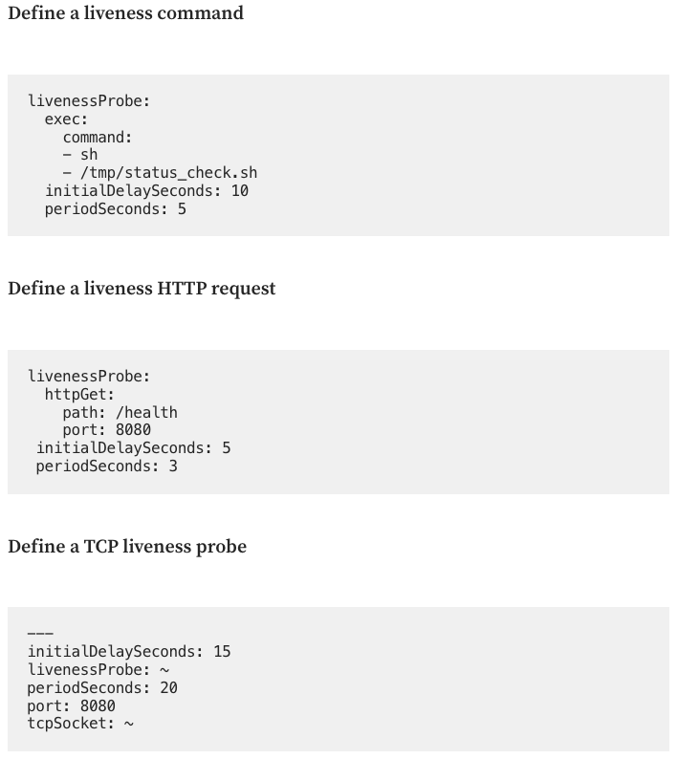
Types of Health Check
Kubernetes supports 3 types Health Checks
Execute a Command/script
HTTP Request
TCP Request

Slide 37
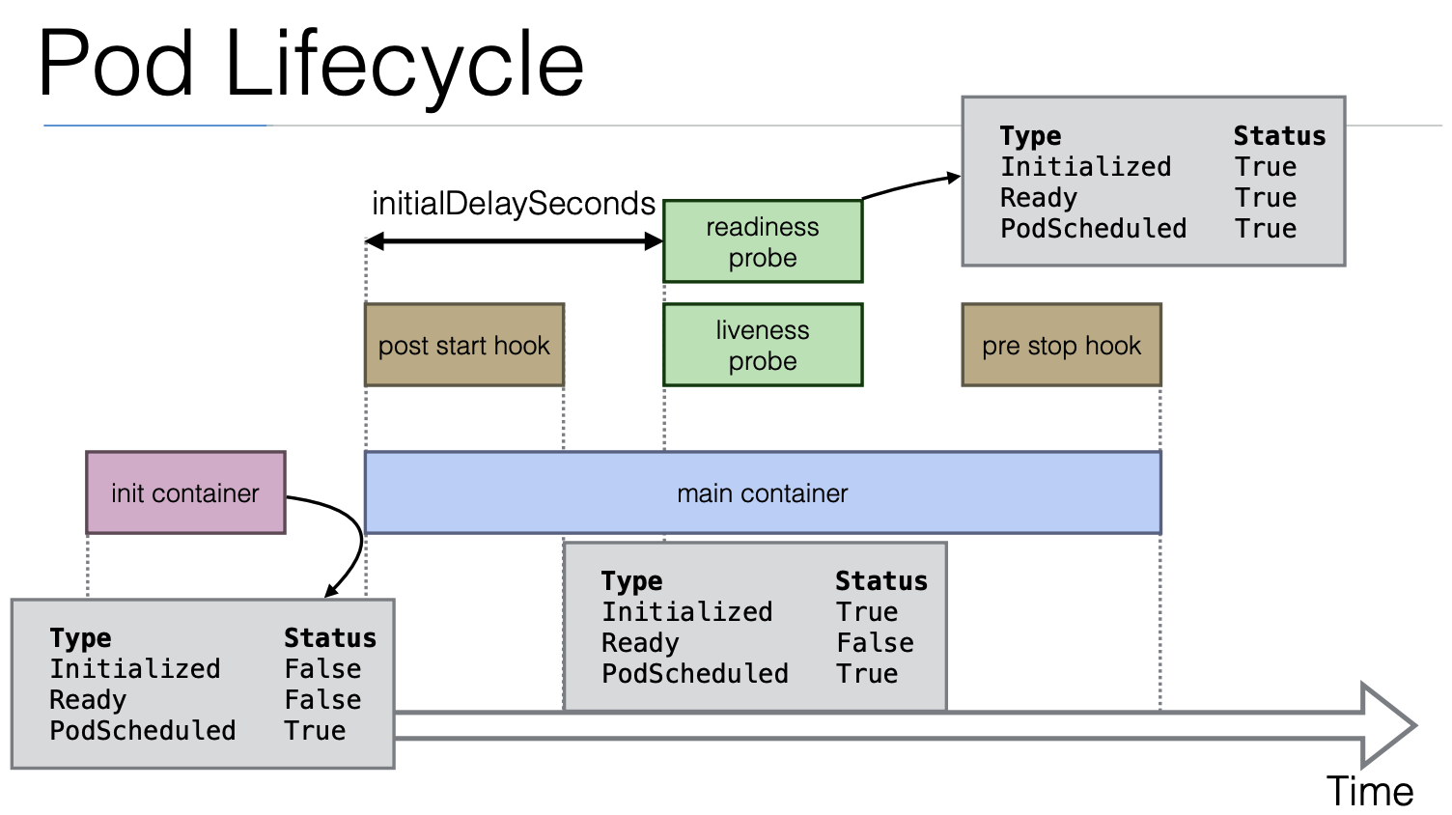
Health Check - Manage Pods LifeCycle

Slide 38
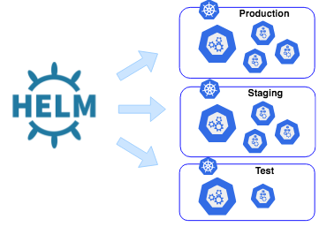
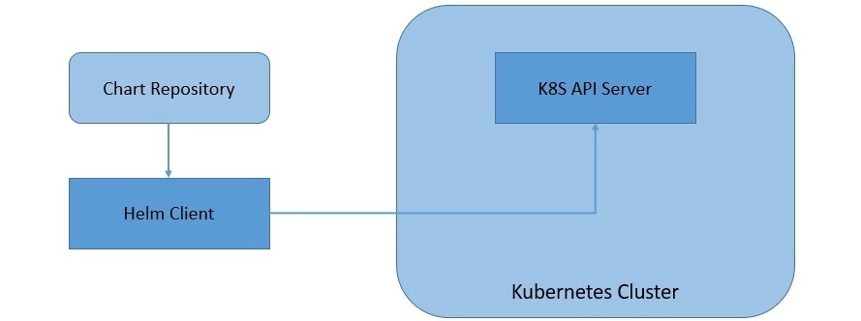
What is Helm Charts?
The scope of the Kubernetes project is to deal with your containers for you, not your template files. This is where Helm comes in - It manages your template files.
Helm Charts provide users with a better way to manage all the Kubernetes YAML files we create on Kubernetes projects. The Kubernetes YAML files can be huge in number and can become complex to manage these files individually.
Helm uses a packaging format called charts. A chart is a collection of files that describe a related set of Kubernetes resources.

Slide 39
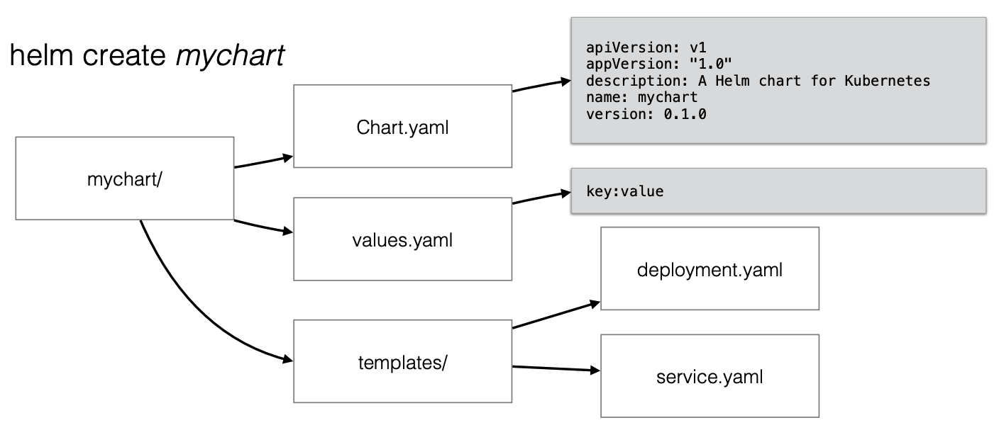
Helm Charts

Slide 40
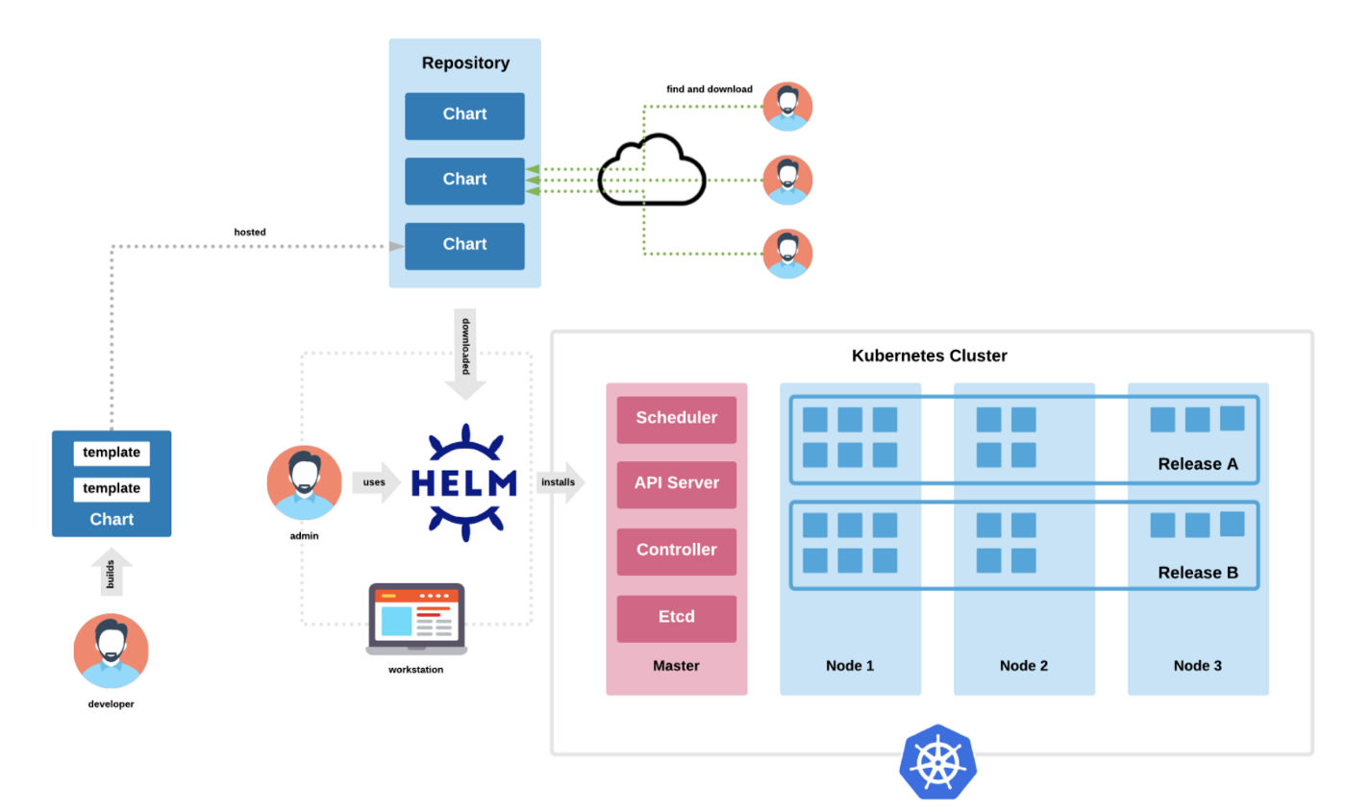
Helm Charts

Slide 41
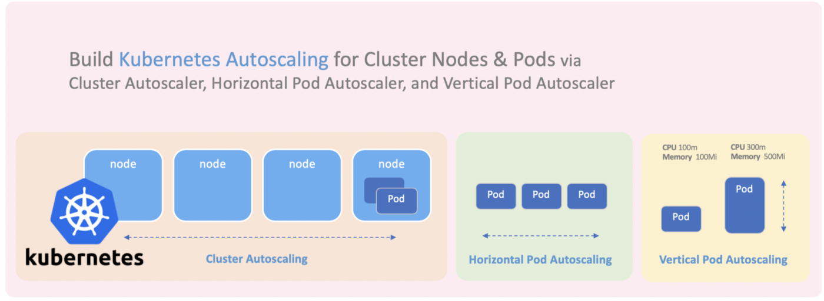
Auto Scaling in Kubernetes - Horizontal & Vertical (Difference/Usecase)
Auto Scaling in Kubernetes
Horizontal Scaling (Stateless Apps/Architecture)
Pods (Scaling Number of Pods) via HorizontalPodAutoscaler (HPA)
Nodes (Scaling Number of Nodes) via Cluster Autoscaler
Vertical Scaling (Stateful App/Architecture)
Pods (Scaling RAM/CPU for Pods) via VerticalPodAutoscaler (VPA)

Slide 42
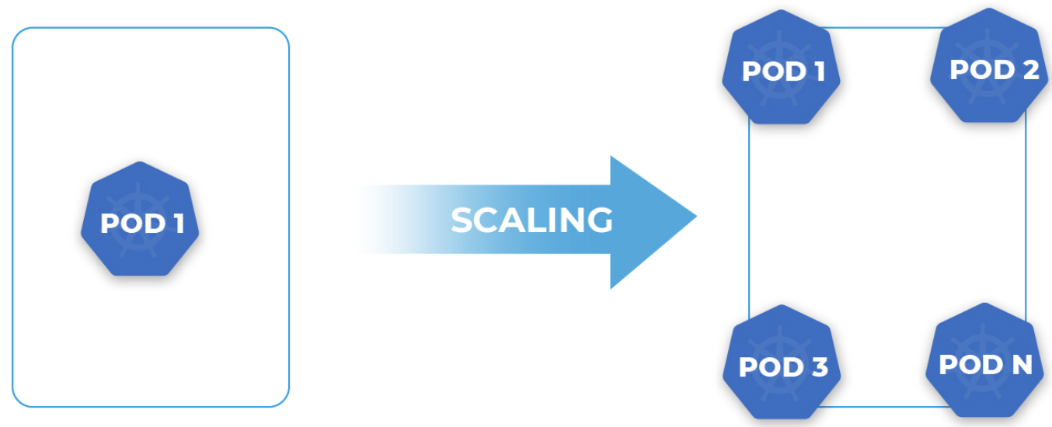
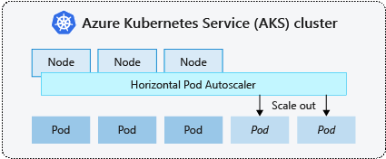
Autoscaling (Horizontal) of Pods in Kubernetes via (HorizontalPodAutoscaler aka HPA)

Slide 43
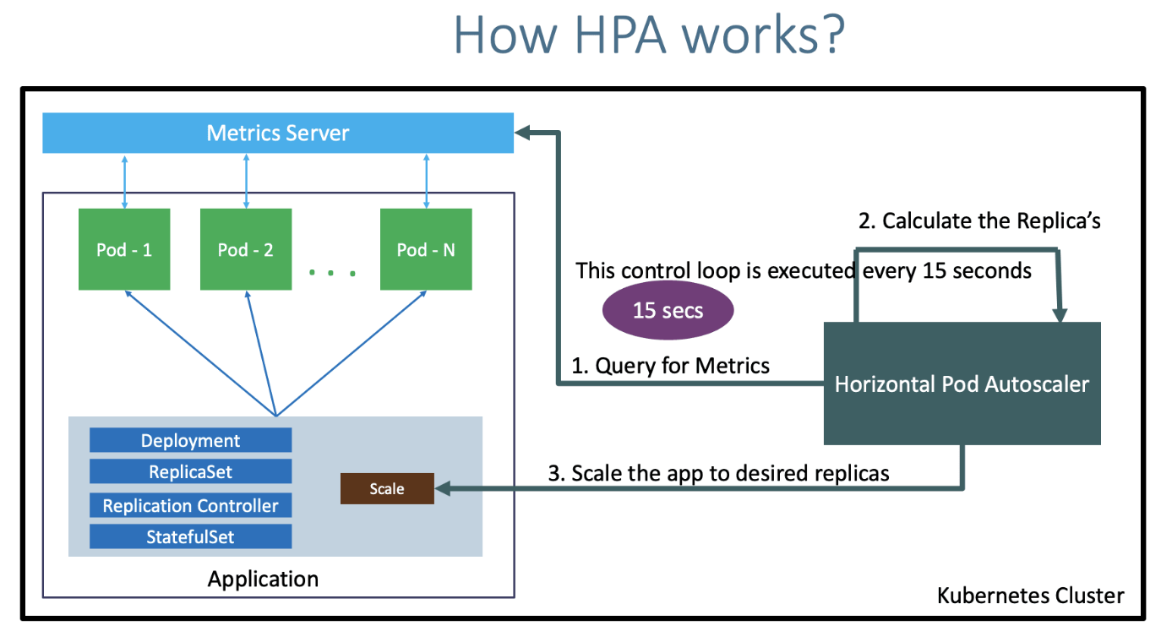
Autoscaling (Horizontal) of Pods in Kubernetes via (HorizontalPodAutoscaler aka HPA)

Slide 44
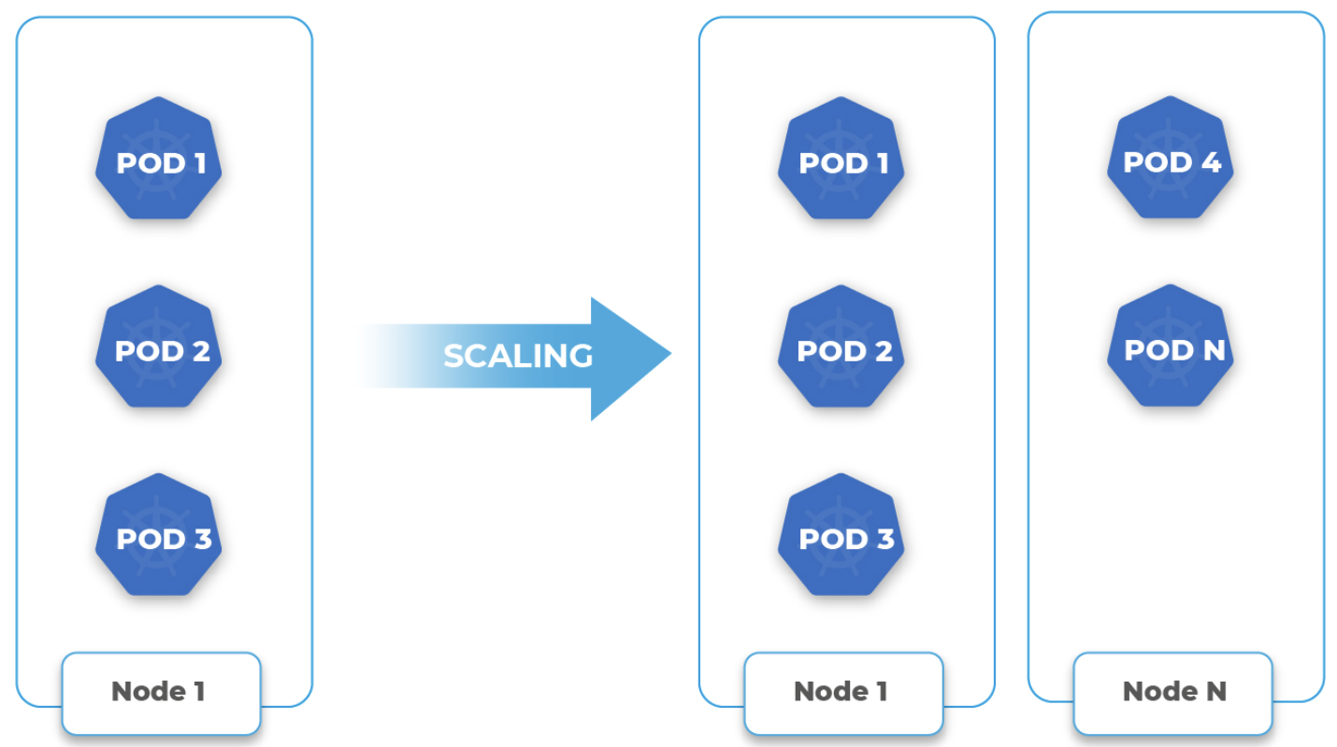
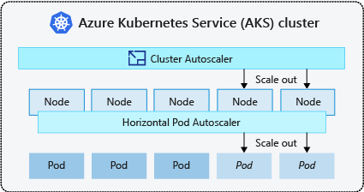
Autoscaling (Horizontal) of Nodes in Kubernetes via (Cluster Autoscaler)

Slide 45

Autoscaling (Vertical) Pods in Kubernetes via (VerticalPodAutoscaler aka VPA)

Slide 46

VerticalPodAutoscaler versus HorizontalPodAutoscaler

Slide 47

Kubernetes Jobs (For Executing App Shielding Runners)

Slide 48


Kubernetes Jobs (For Executing App Shielding Runners)
Add Auto Scaling Support for Kubernetes Jobs
Horizontal Scaling
Pods (Scaling Number of Pods) via HorizontalPodAutoscaler (HPA)
Nodes (Scaling Number of Nodes) via Cluster Autoscaler

Slide 49

Kubernetes Dashboards/UIs
Kubernetes Dashboard (kube-dashboard) [most mature and popular] Officially supported
Lens [most powerful one]
Octant [easy to install and most portable]
kubenav [Android and iOS support]

Slide 50




Slide 51

What is Terraform? - Infrastructure As Code (IAC)

Slide 52

What is Terraform? - Infrastructure As Code (IAC)

Slide 53

Terraform vs Kubernetes

Slide 54

Terraform for Kubernetes
https://git.onespan.com/devops-shared-platform/terraform/osp-aws-eks

Slide 55
Demo/Code Review for our App Shielding K8s Cluster
Demo/Code Review for Frontend/Backend (Pods, ReplicaSets, Deployments) - App Shielding Code/Repo
Frontend (https://git.onespan.com/mob/saas/rasp-project-fe/-/blob/main/helm/values.tmpl.yaml)
Projects (https://git.onespan.com/mob/saas/rasp-project-be/-/blob/main/helm/values.tmpl.yaml)
Shielder (https://git.onespan.com/mob/saas/rasp-shielder-be/-/blob/main/helm/values.tmpl.yaml)
Config (https://git.onespan.com/mob/saas/rasp-configuration-be/-/blob/main/helm/values.tmpl.yaml)
Shielding (https://git.onespan.com/mob/saas/rasp-shielding-be/-/blob/main/helm/values.tmpl.yaml)
Demo/Code Review for our App Shielding K8s Cluster (K8s, Ingress/Services, Routing) - Platform Code/Repo
Ingress:https://git.onespan.com/devops-shared-platform/helm/osp-stateless-app/-/blob/main/templates/ingress.yaml
Services:https://git.onespan.com/devops-shared-platform/helm/osp-stateless-app/-/blob/main/templates/service.yaml

Slide 56

Sample Infrastructure Diagram

Slide 57
Thank you

Slide 58
Appendix
Sources
Health Checks
https://medium.com/avmconsulting-blog/how-to-perform-health-checks-in-kubernetes-k8s-a4e5300b1f9d
Ingress
https://medium.com/devops-mojo/kubernetes-ingress-overview-what-is-kubernetes-ingress-introduction-to-k8s-ingress-b0f81525ffe2
https://www.eksworkshop.com/beginner/130_exposing-service/ingress/
https://medium.com/towards-data-science/how-to-set-up-ingress-controller-in-aws-eks-d745d9107307
Load Balancer
https://www.containiq.com/post/kubernetes-load-balancer
Helm Charts
https://www.baeldung.com/ops/kubernetes-helm
Kubernetes
https://medium.com/devops-mojo/kubernetes-architecture-overview-introduction-to-k8s-architecture-and-understanding-k8s-cluster-components-90e11eb34ccd
Services
https://medium.com/devops-mojo/kubernetes-service-types-overview-introduction-to-k8s-service-types-what-are-types-of-kubernetes-services-ea6db72c3f8c
https://awstip.com/why-i-stumbled-upon-confluence-between-aws-load-balancers-and-kubernetes-service-c8603537ac9b
Helm Charts
https://www.baeldung.com/ops/kubernetes-helm
https://www.freecodecamp.org/news/what-is-a-helm-chart-tutorial-for-kubernetes-beginners/
AutoScaling
https://blog.scaleway.com/understanding-kubernetes-autoscaling/
https://www.clickittech.com/devops/kubernetes-autoscaling/
https://learnk8s.io/kubernetes-autoscaling-strategies

Slide 59
Number of pods and their resources (CPU/RAM) for App Shielding
Step 1: Define NFRs (Non Functional Requirements) e.g.
SLA: 90% of the APIs should send the response within 2 seconds (Exception: S3 Upload/Download/Shielding)
Max Concurrent Users: 200 users
Average Concurrent Users: 1-5 users
Step 2: Start with estimate resources (Number of Pods and CPU/RAM)
Assuming 1 Pod with 1 CPU/0.5m RAM can serve 5 concurrent users within 2 seconds for each API request.
Start with 2 Pods of 1 CPU/0.5m RAM for each Microservice to serve 5 concurrent users + High Availability.
Set up Autoscaling for Horizontal Pods and Nodes, when the CPU/RAM utilization goes above 80% for more than 1-2 minutes, to support the max concurrent 300 users and Autoscale down for idle pods/nodes.
Step 3: Load Test the Infrastructure with Max/Average Users and Collect Pods CPU/RAM Usage & Response Time
Collect the Pods CPU/RAM Usage and Response Time for Max and Average Concurrent Users
Update the estimate resources with the new resources (CPU/RAM and Number of Pods) based on the Load Test data (collected pod CPU/RAM usage) and response time.
Test if Autoscaling supports max concurrent 300 users and if it autoscale down after.
Step 4: Repeat the Load Test with Max/Average Users and Update the resources and autoscaling.
Continue to repeat the Load Test with Max/Average Users and update the resources accurate numbers until the SLA is met with optimal resource utilization.
Continue to Test Autoscaling Up and Down, until optimal performance is achieved.

Slide 60

Number of pods and their resources (CPU/RAM) for App Shielding

Slide 61


Number of pods and their resources (CPU/RAM) for App Shielding

Slide 62

Number of pods and their resources (CPU/RAM) for App Shielding

Slide 63

Number of pods and their resources (CPU/RAM) for App Shielding

